Slide 1

Performance Evaluation-Regression

Slide 2
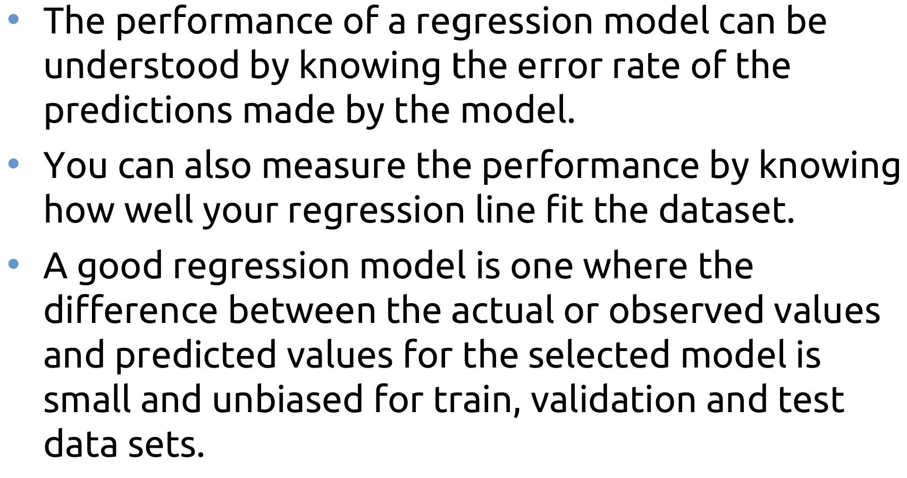
Performance Evaluation
Fairleigh Dickinson University

Slide 3
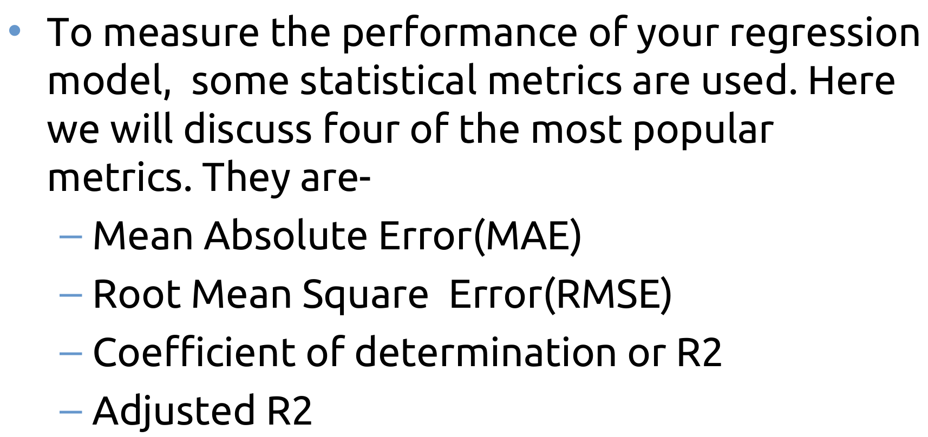
Performance Evaluation
Fairleigh Dickinson University

Slide 4
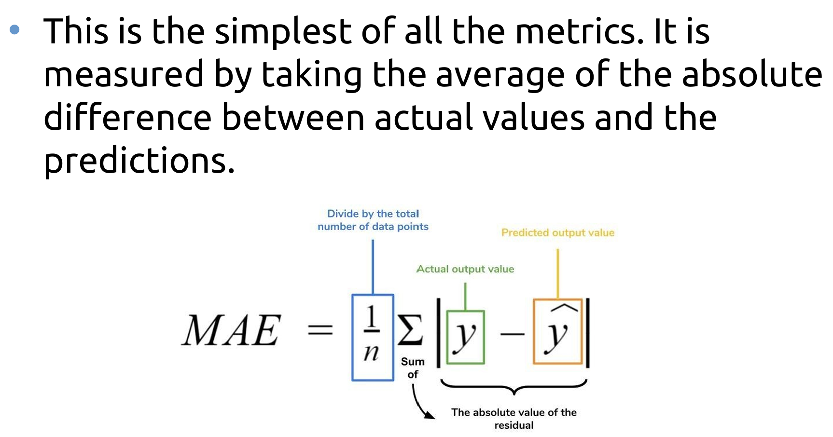
Mean Absolute Error
Fairleigh Dickinson University

Slide 5
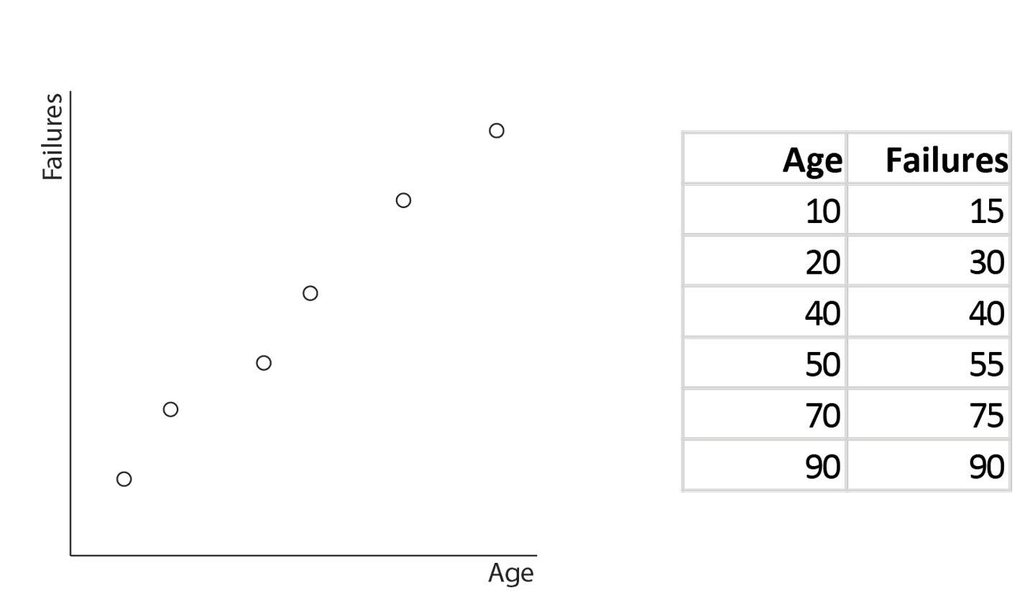
Example
Fairleigh Dickinson University

Slide 6
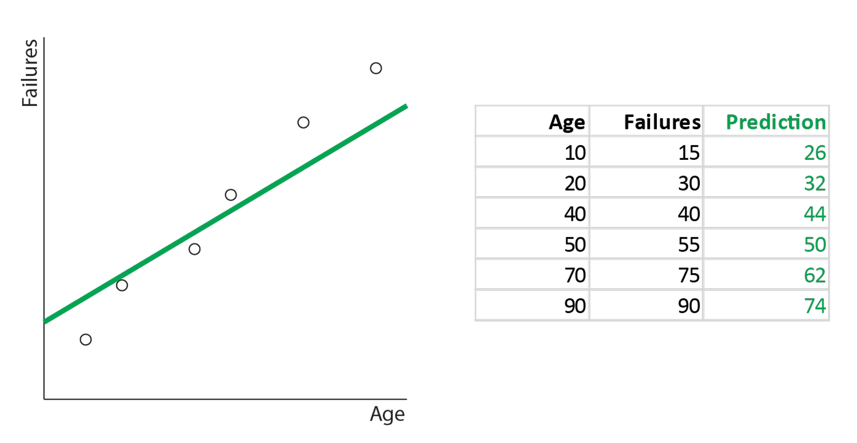
Example
Fairleigh Dickinson University

Slide 7
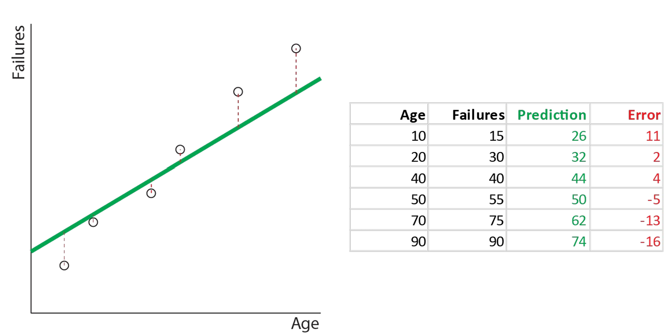
Example
Fairleigh Dickinson University

Slide 8
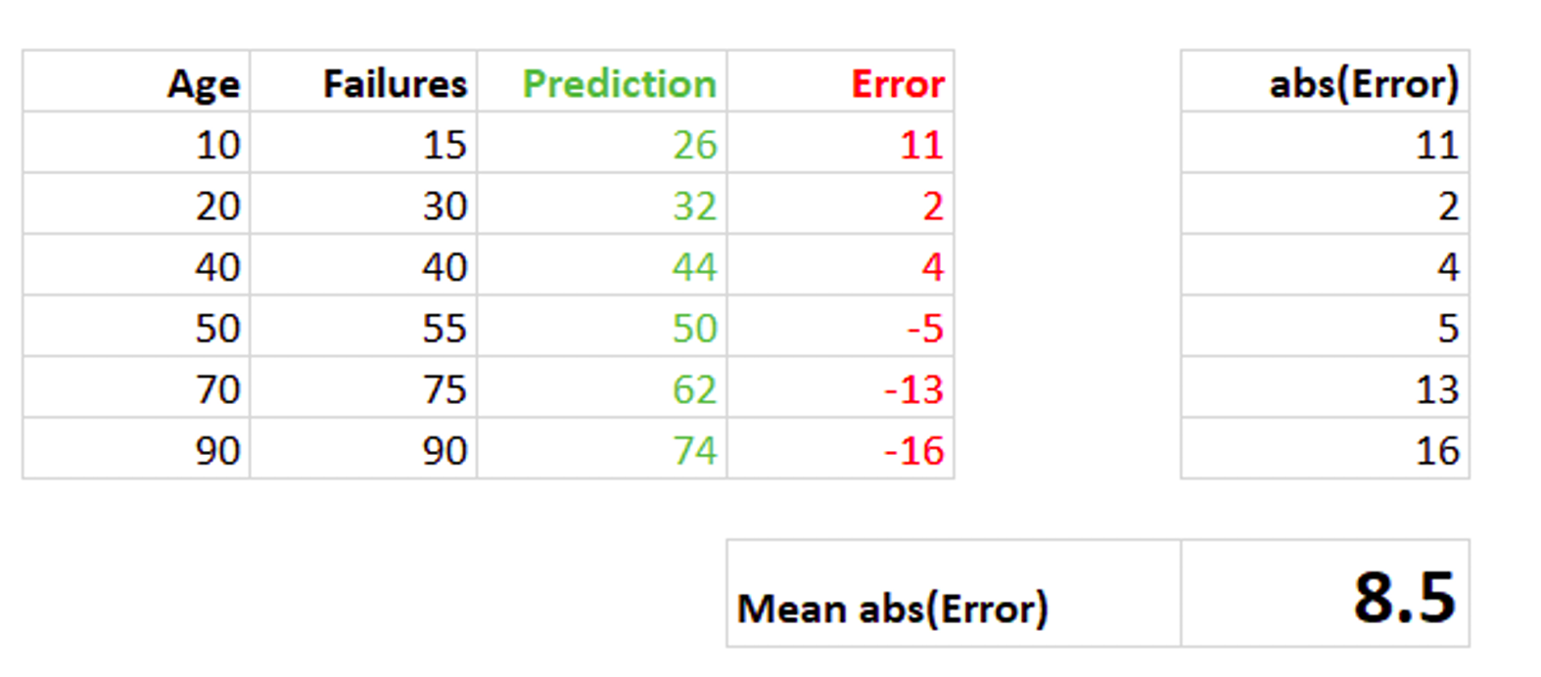
Mean Absolute Error
Fairleigh Dickinson University

Slide 9
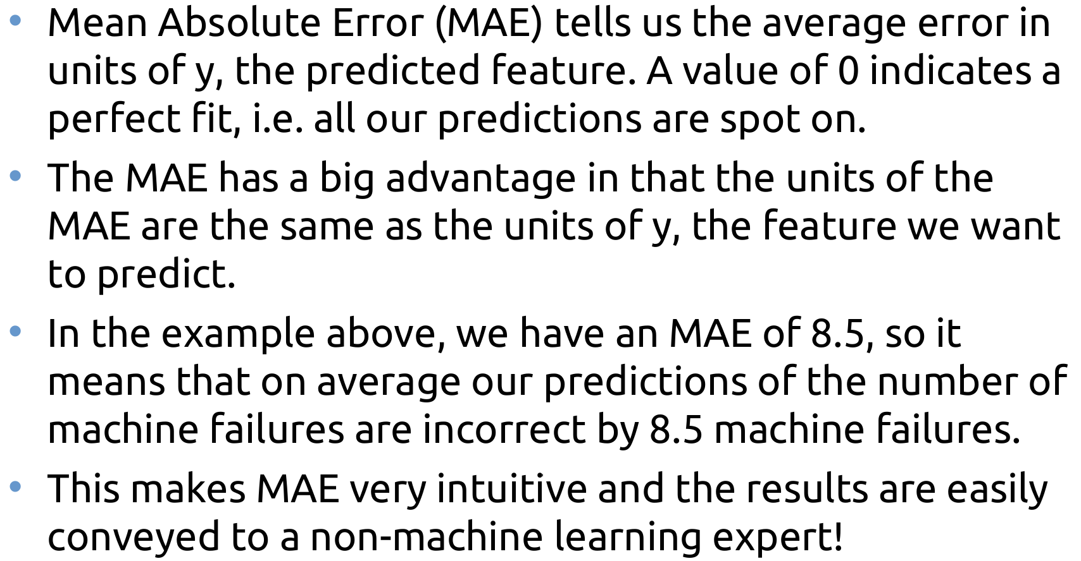
Mean Absolute Error
Fairleigh Dickinson University

Slide 10
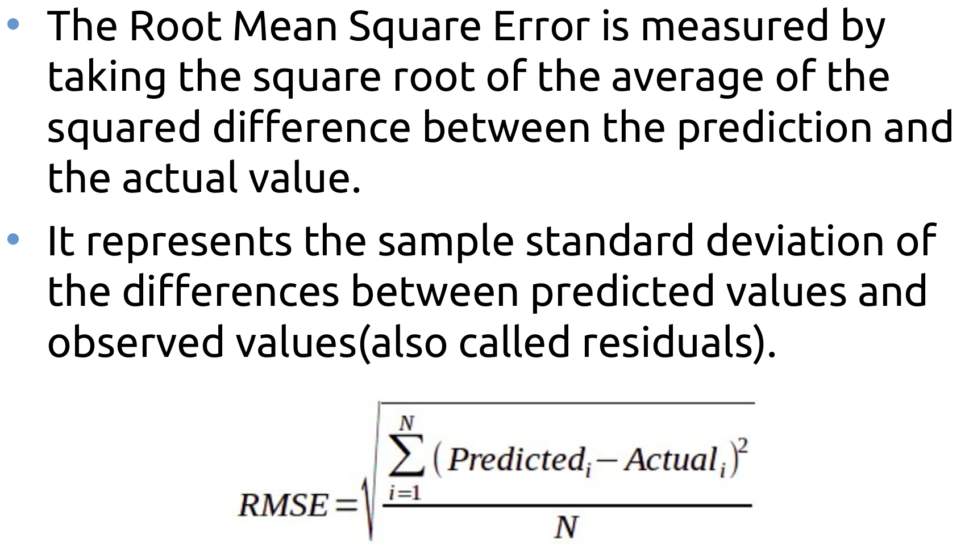
Root Mean Square Error
Fairleigh Dickinson University

Slide 11
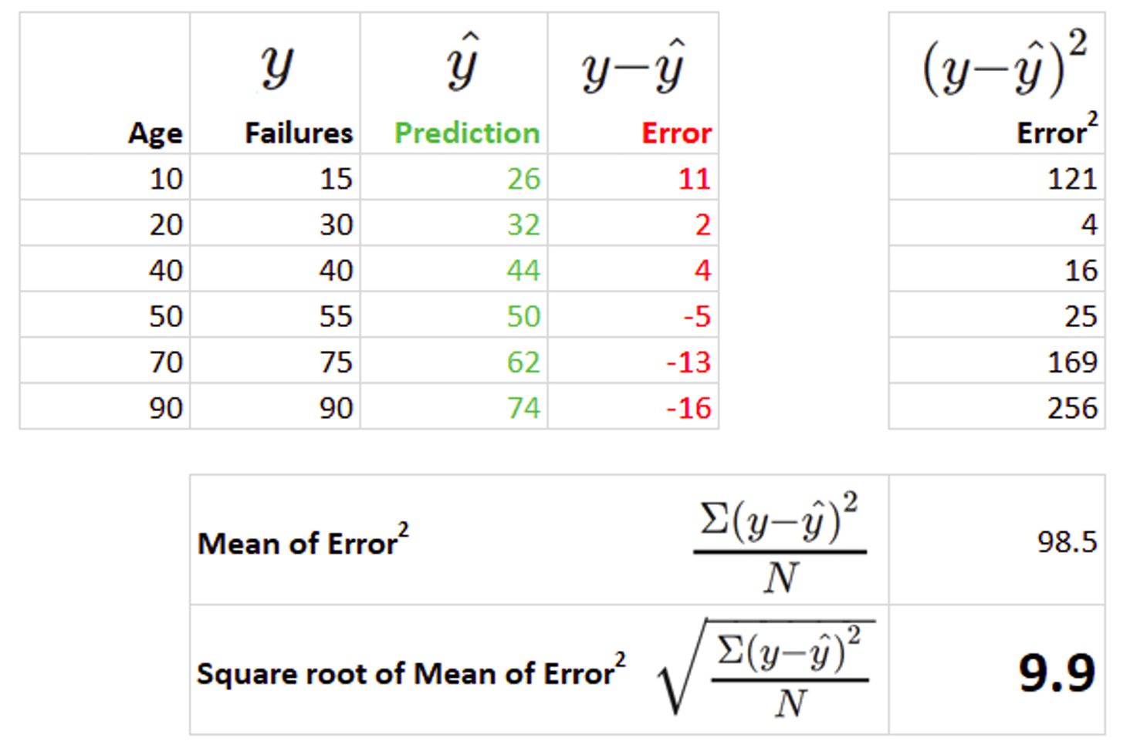
Root Mean Square Error
Fairleigh Dickinson University

Slide 12
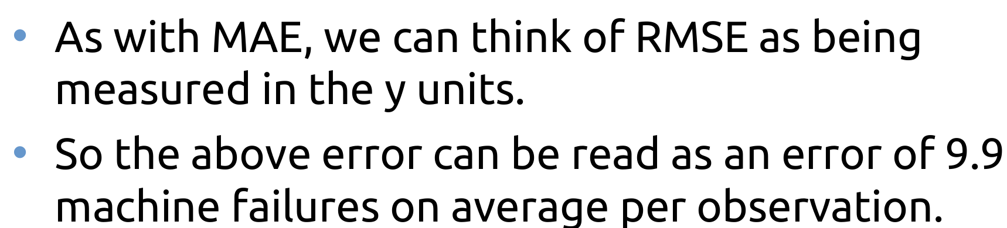
RMSE
Fairleigh Dickinson University

Slide 13
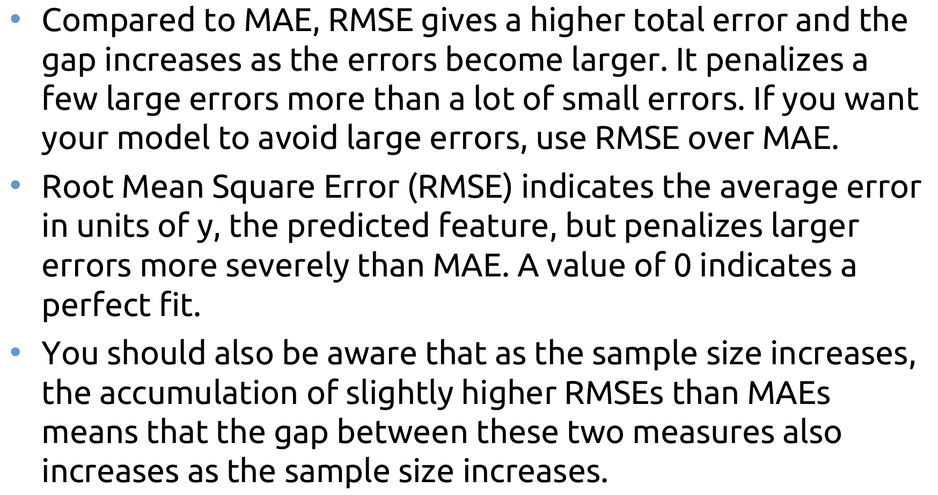
MAE vs RMSE
Fairleigh Dickinson University

Slide 14
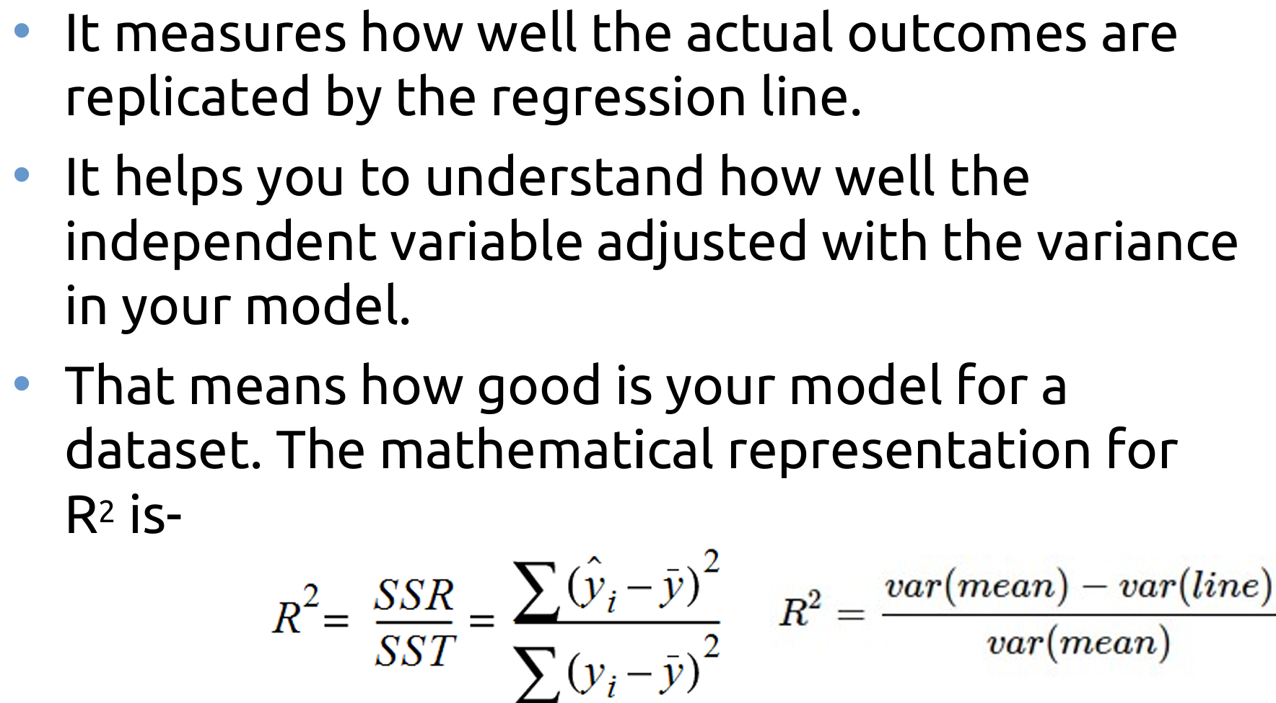
R² Error
Fairleigh Dickinson University

Slide 15
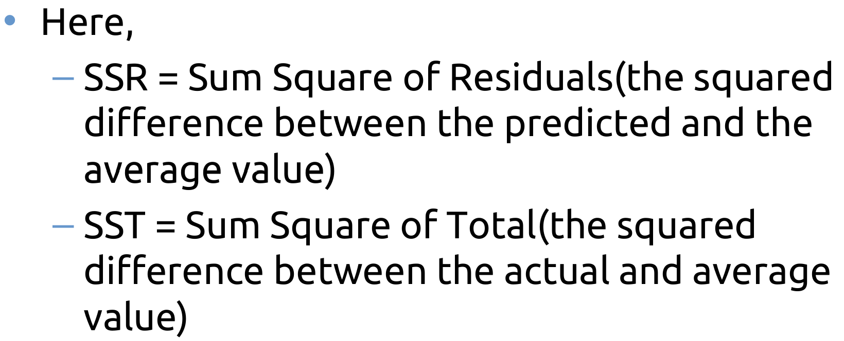
R² Error
Fairleigh Dickinson University

Slide 16
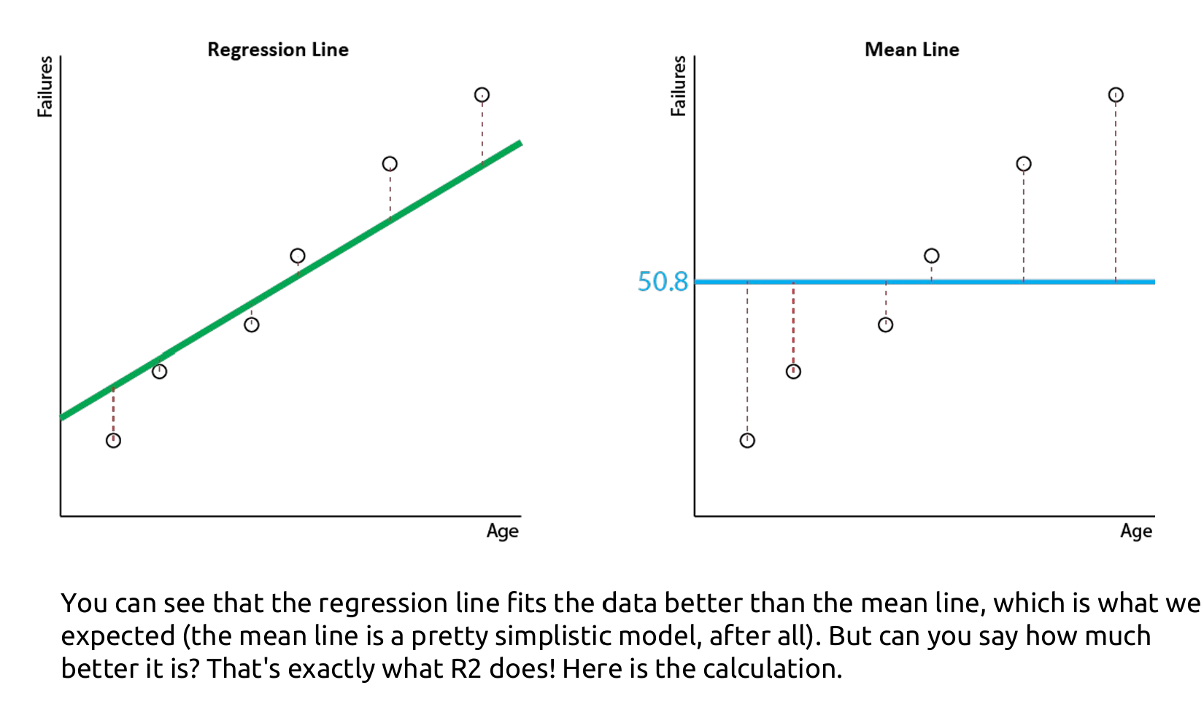
Example
Fairleigh Dickinson University

Slide 17
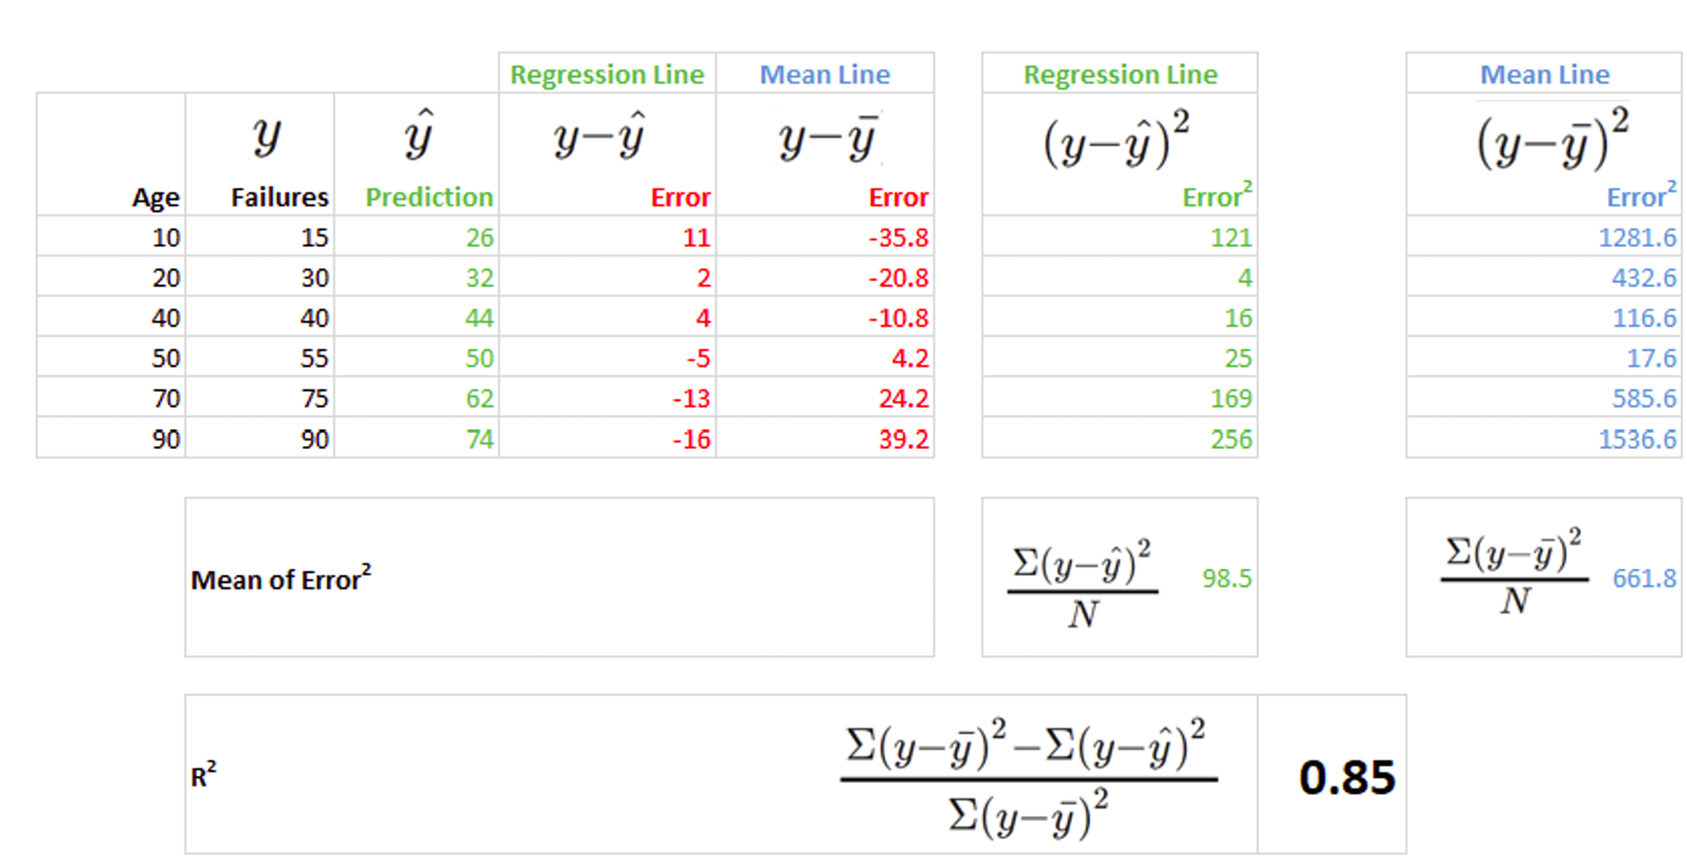
Example
Fairleigh Dickinson University

Slide 18
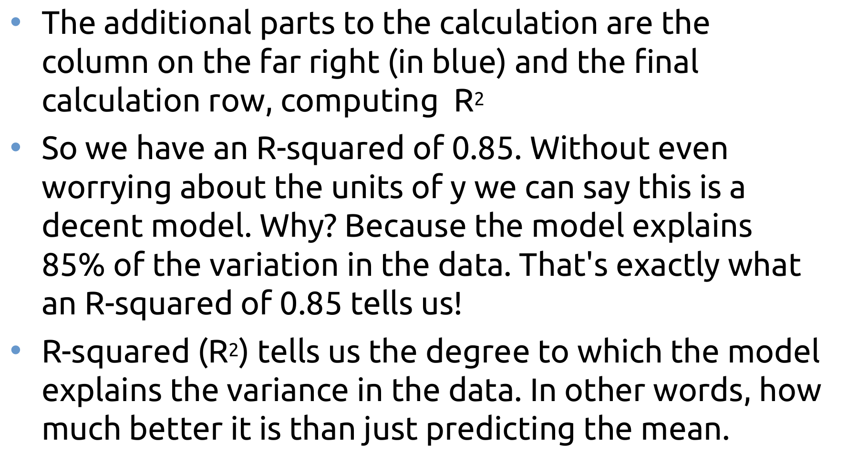
R² Error
Fairleigh Dickinson University

Slide 19
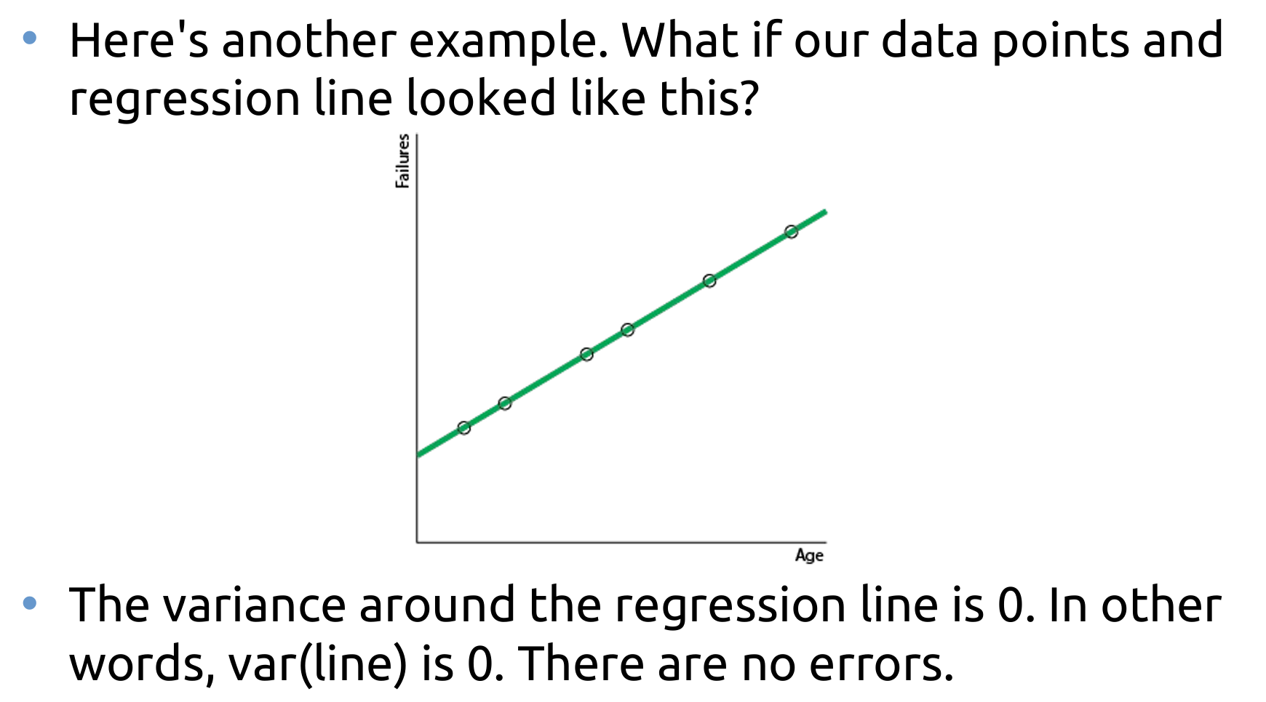
Example
Fairleigh Dickinson University

Slide 20
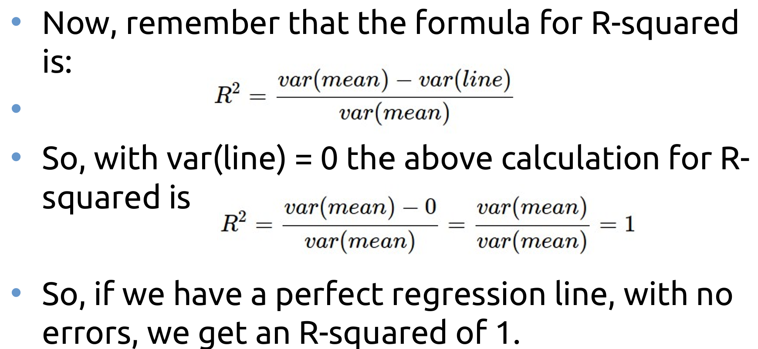
Now
Fairleigh Dickinson University

Slide 21
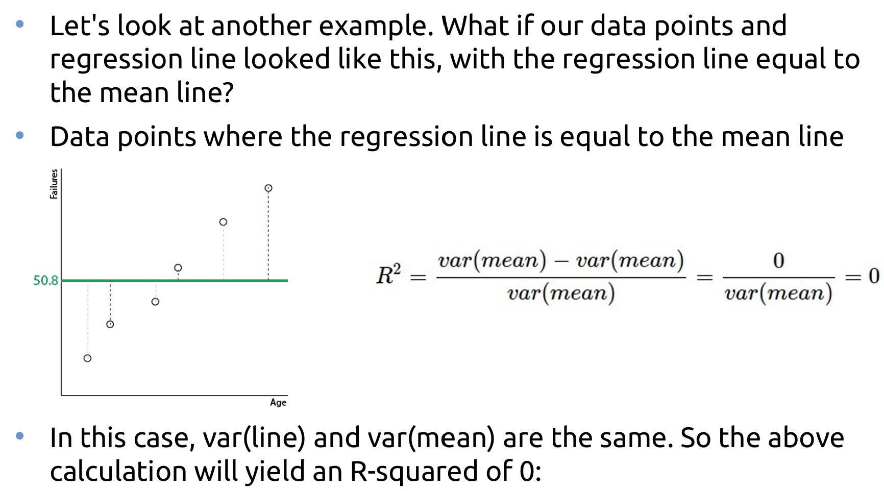
R² Error
Fairleigh Dickinson University

Slide 22
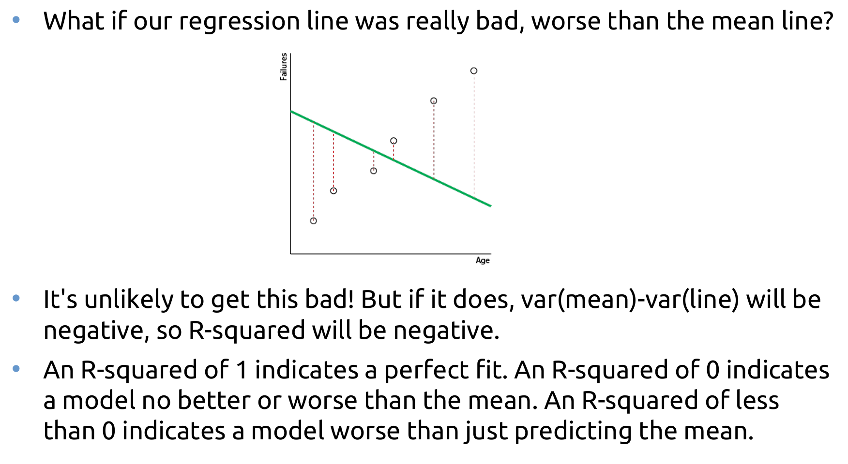
R² Error
Fairleigh Dickinson University

Slide 23
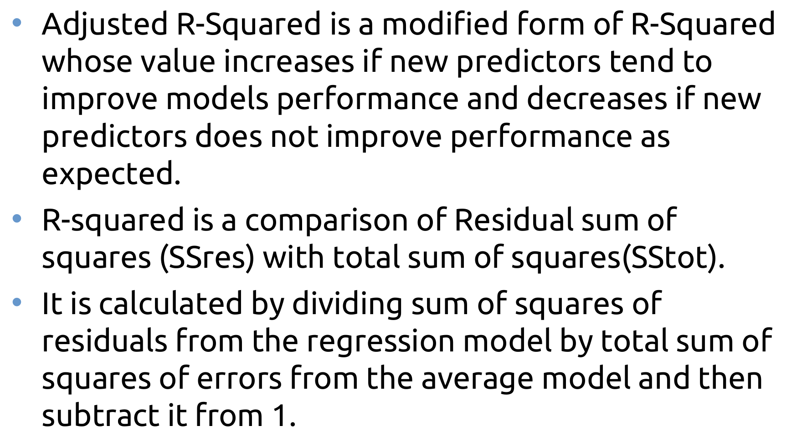
Adjusted R² Error
Fairleigh Dickinson University

Slide 24
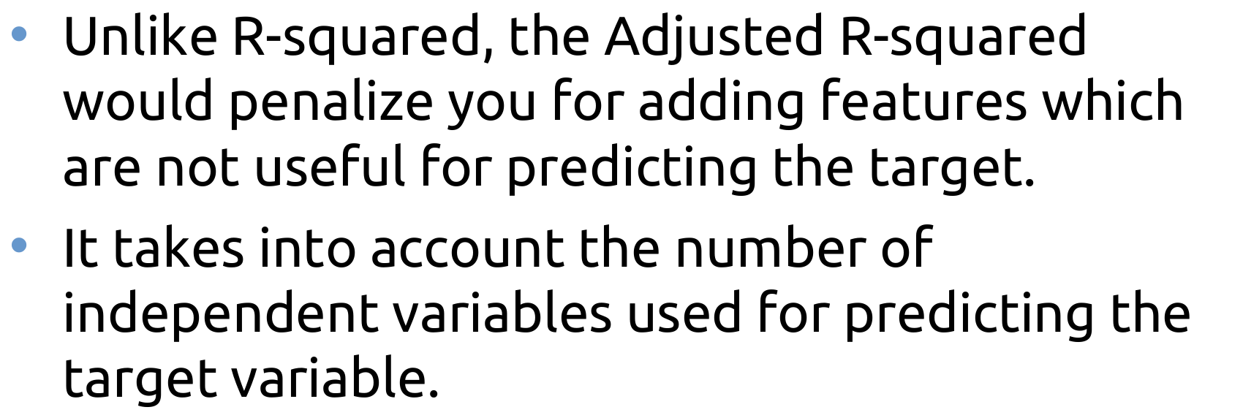
Adjusted R² Error
Fairleigh Dickinson University

Slide 25
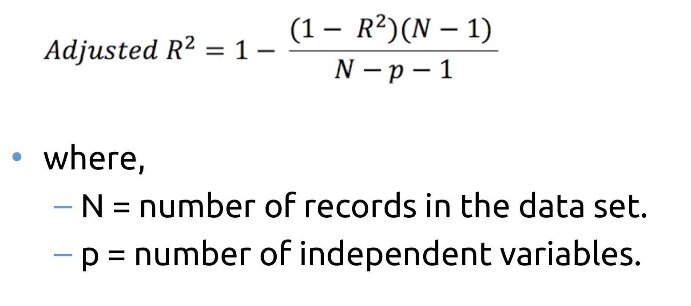
Adjusted R² Error
Fairleigh Dickinson University

Slide 26
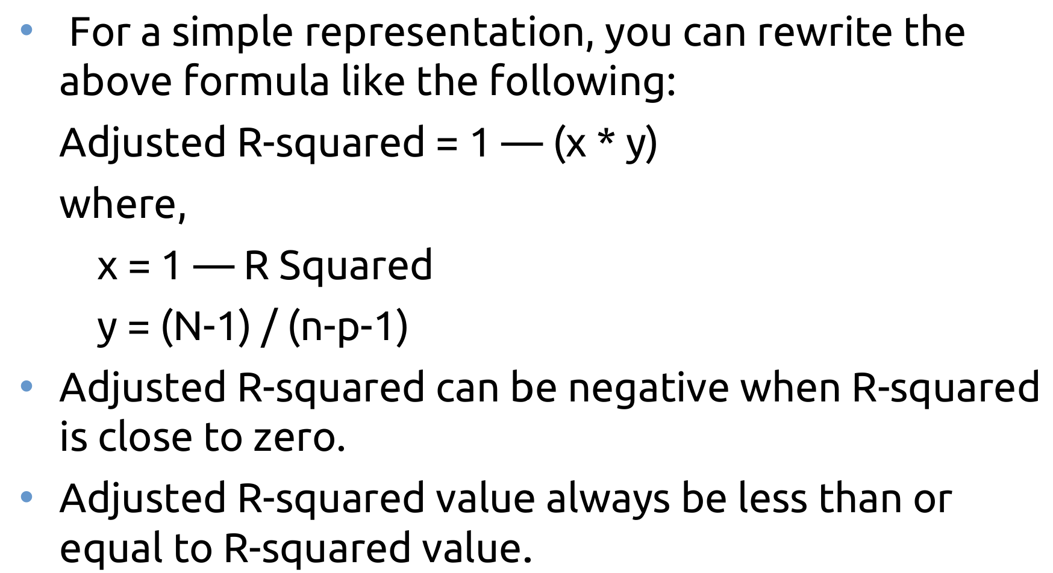
Adjusted R² Error
Fairleigh Dickinson University

Slide 27
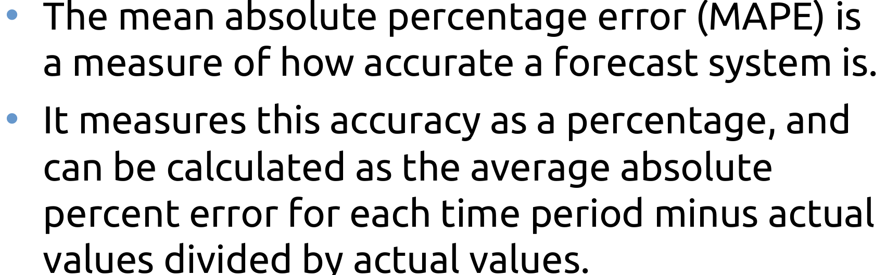
Mean Absolute Percentage Error(MAPE)
Fairleigh Dickinson University

Slide 28
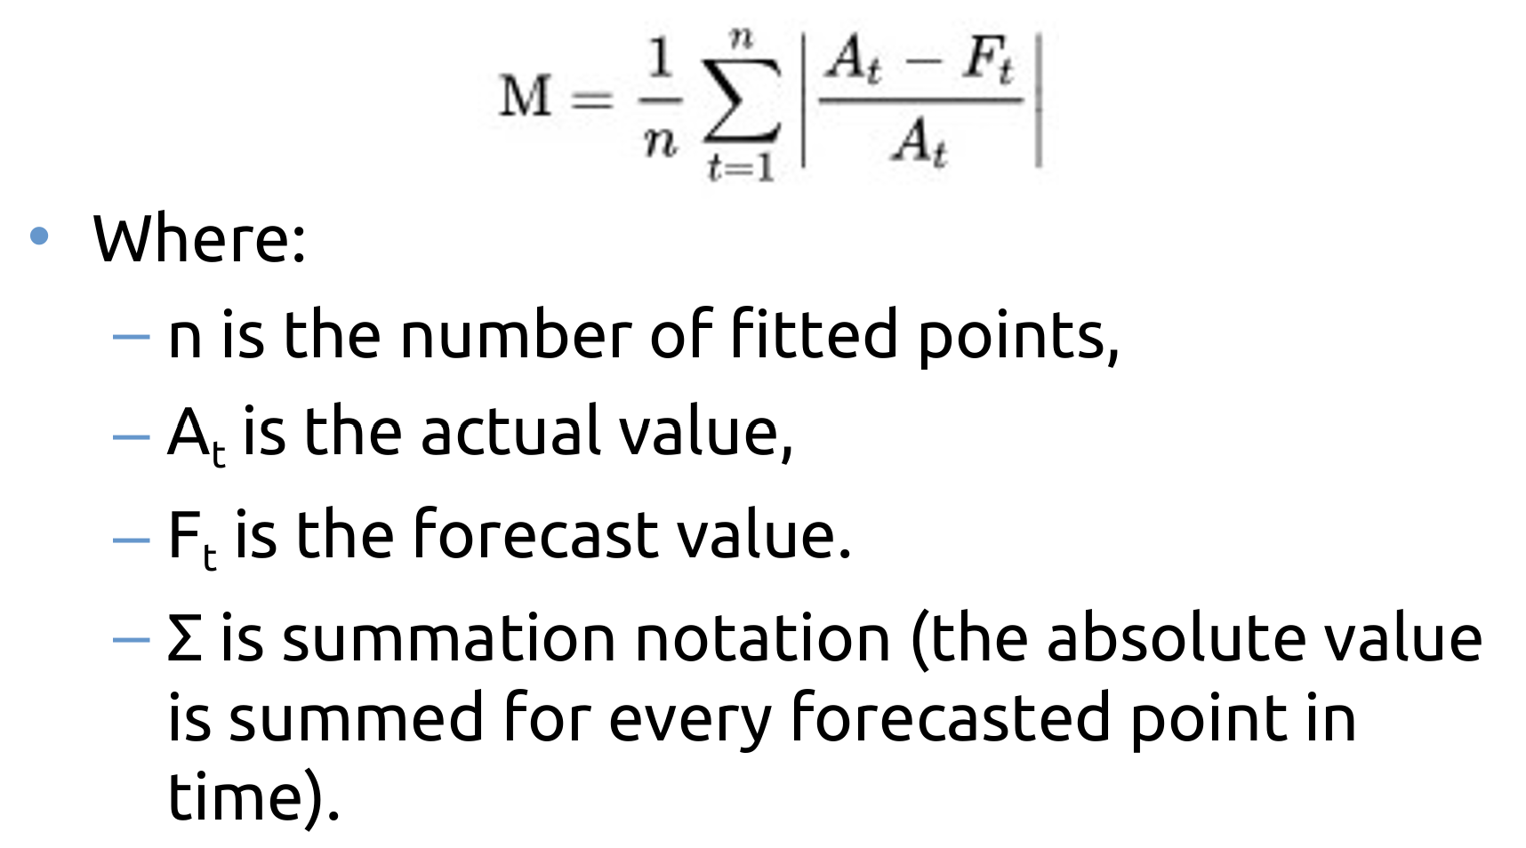
Mean Absolute Percentage Error(MAPE)
Fairleigh Dickinson University

Slide 29
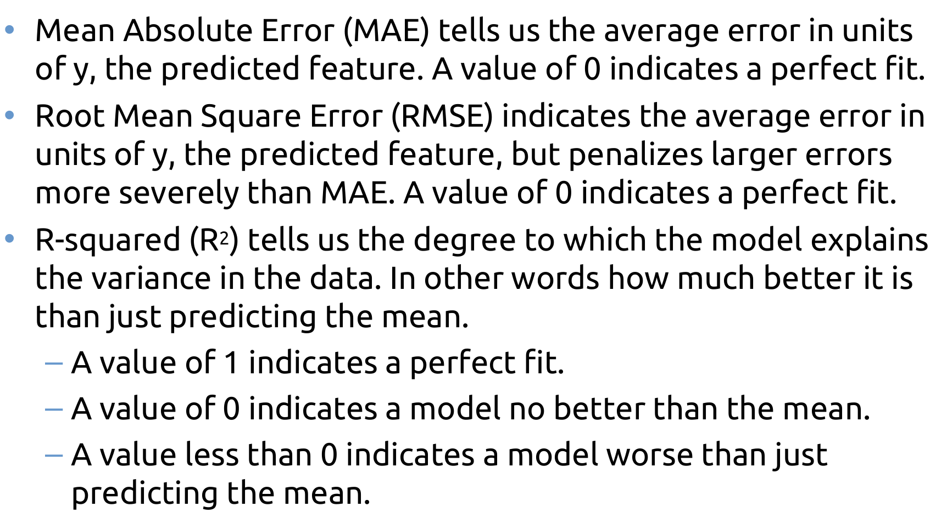
Summary
Fairleigh Dickinson University

